Slide 1
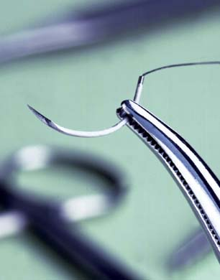
SUTURE MATERIALS AND TECHNIQUES
Lecturer: A. MUNAHI
Dep: Surgery & Obstetrics
4th stage Practical Surgery Lectures

Slide 2
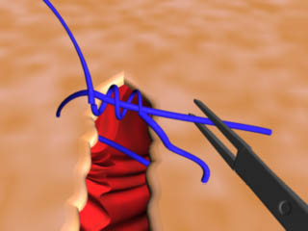
The Ideal Suture Material
Can be used in any tissue
Easy to handle
Good knot security
Minimal tissue reaction

Slide 3
The Ideal Suture Material
Unfriendly to bacteria
Strong yet small
Won’t tear through tissues
Cheap

Slide 4
What’s It Used for?
To bring tissue edges together and speed wound healing (=tissue apposition)
Orthopedic surgery to help stabilize joints
Repair ligaments
Ligate vessels or tissues

Slide 5
Types of Needles
Eyed needles
More Traumatic
Only thread through once
Suture on a reel
Tends to unthread itself easily

Slide 6
Types of Needles
Swaged-on needles
Much less traumatic
More expensive suture material
Sterile

Slide 7
Points of Needles
Taper
Atraumatic
Internal organs

Slide 8
Points of Needles
Cutting
Cutting edge on inside of circle
Skin
Traumatic

Slide 9
Points of Needles
Reverse Cutting
Cutting edge on outside of circle
Skin
Less traumatic than cutting

Slide 10
Cutting vs Reverse Cutting
Cutting
Reverse cutting

Slide 11
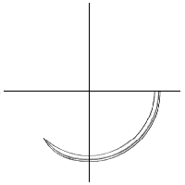
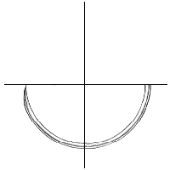
Shapes of Needles
3/8 circle
1/2 circle
Straight
Specialty

Slide 12
Characteristics of Suture Material
Absorbable Vs. Nonabsorbable
Monofilament Vs. Multifilament
Natural or Synthetic

Slide 13
Absorbable Sutures
Internal
Intradermal/ subcuticular
Rarely on skin

Slide 14
Non-absorbable Suture
Primarily Skin
Needs to be removed later
Stainless steel = exception
Can be used internally
Ligature
Orthopedics
Can be left in place for long periods

Slide 15
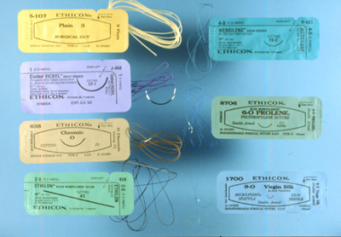

Slide 16
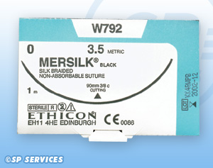
Reading the Suture Label
Order Code
Size
Also:
LENGTH
NEEDLE SYMBOL
COLOR
Absorbable or Non
Name
Needle
Company

Slide 17
Choosing Absorbable Vs. Nonabsorbable
How long you need it to work
Do you want to see the animal again for suture removal

Slide 18
Monofilament Vs. Multifilament
memory easy to handle
less tissue drag more tissue drag
doesn’t wick wicks/ bacteria
poor knot security good knot security
- tissue reaction +tissue reaction

Slide 19
Natural Vs. Synthetic
Natural:
Gut
Chromic Gut
Collagen
All are absorbable

Slide 20
Gut/ Chromic Gut
Made of submucosa of small intestines
Multifilament
Breaks down by phagocytosis: inflammatory reaction common

Slide 21
Gut/ Chromic Gut
Chromic: tanned, lasts longer, less reactive
Easy handling
Plain: 3-5 days
Chromic: 10-15 days
Bacteria love this stuff!

Slide 22
Collagen and Silk
Natural sutures
VERY reactive, absorbable
Ophthalmic surgery only

Slide 23
Vicryl (Polyglactin 910)
Braided, synthetic, absorbable
Stronger than gut: retains strength 3 weeks
Broken down by enzymes, not phagocytosis
Break-down products inhibit bacterial growth
Can use in contaminated wounds, unlike other multifilaments

Slide 24
Dexon and PGA
Polymer of glycolic acids
Braided, synthetic, absorbable
Broken down by enzymes
Both PGA and dexon have increased tissue drag, good knot security
Both are stronger than gut

Slide 25
PDS (polydioxine)
Monofilament (less drag, worse knot security – lots of “memory”)
Synthetic, absorbable
Very good tensile strength (better than gut, vicryl, dexon) which lasts months
Absorbed completely by 182 days

Slide 26
Maxon (polyglyconate)
Monofilament- memory
Synthetic Absorbable
Very little tissue drag
Poor knot security
Very strong

Slide 27
NONABSORBABLE SUTURES
Natural or Synthetic
Monofilament or multifilament

Slide 28
NYLON
Synthetic
Mono or Multifilament
Memory
Very little tissue reaction
Poor knot security

Slide 29
Polymerized Caprolactum
Vetafil, Braunamid, Supramid
Multifilament suture with protein coating
Synthetic
Good knot security, easy handling
Not very reactive
Don’t use in contaminated wound
Usually comes on a reel

Slide 30
Polypropylene
Prolene, Surgilene
Monofilament, Synthetic
Won’t lose tensile strength over time
Good knot security
Very little tissue reaction

Slide 31
Stainless Steel
Monofilament
Strongest !
Great knot security
Difficult handling
Can cut through tissues
Very little tissue reaction, won’t harbor bacteria

Slide 32
Suture Sizes
Sized #5-4-3-2-1-0-00-000-0000…30-0
BIGGER >>>>>>>>>>>>>>>>SMALLER
00 = 2-0, “two ought”
SA : 0 through 3-0 (Optho 5-0 >>7-0)
LA : 0 through 3

Slide 33
Suture Sizes (cont)
Stainless Steel
In gauges (like needles)
Smaller gauge = bigger, stronger
Larger gauge= smaller, finer
26 gauge = “ought”
28 gauge = 2-0

Slide 34
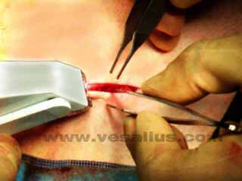
Skin Staples
Very common in human medicine
Expensive
Very easy
Very secure
Very little tissue reaction
Removal =
Special tool required

Slide 35
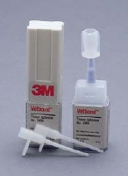
Tissue Adhesive
Nexaband, Vetbond, and others
Little strength
Should not be placed between skin layers or inside body

Slide 36
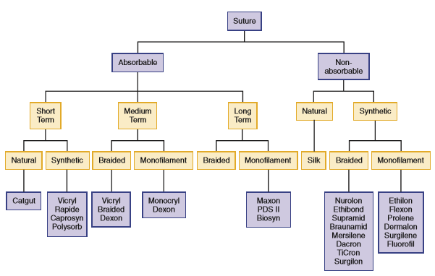

Slide 38
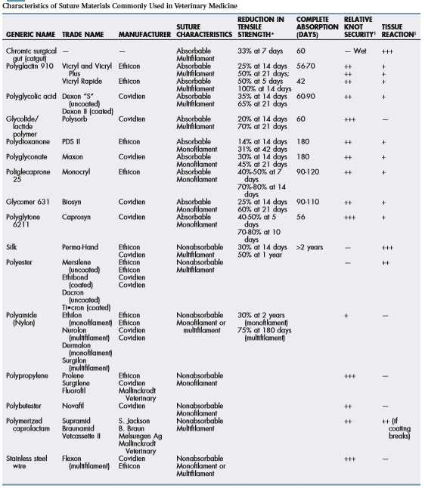

Slide 39
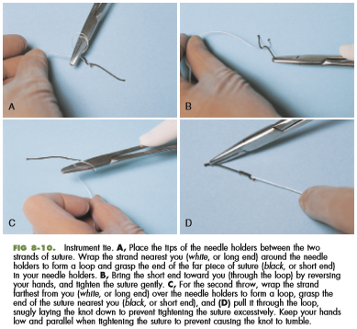
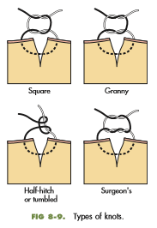

Slide 40
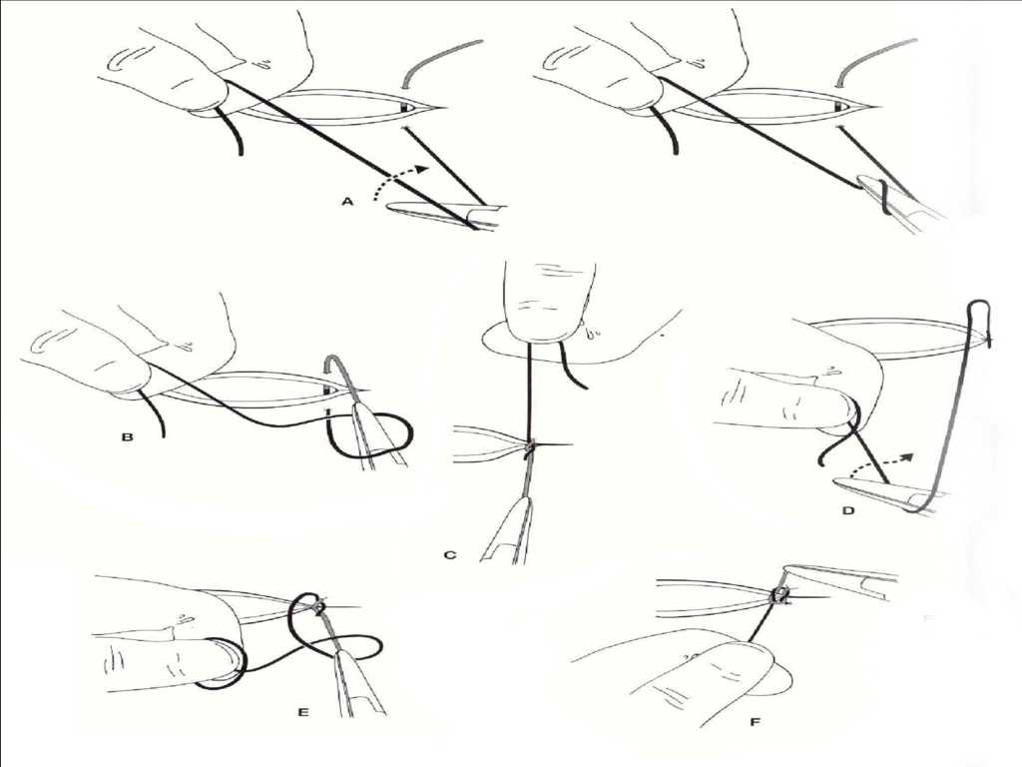
Instrument tying

Slide 41
Knot Strength
Generally 4 “throws” for >90% knot security (nylon may need 5)
Less “throws” = more likely to untie itself
Stainless steel = exception again
2 “throws” = 99% knot security

Slide 42
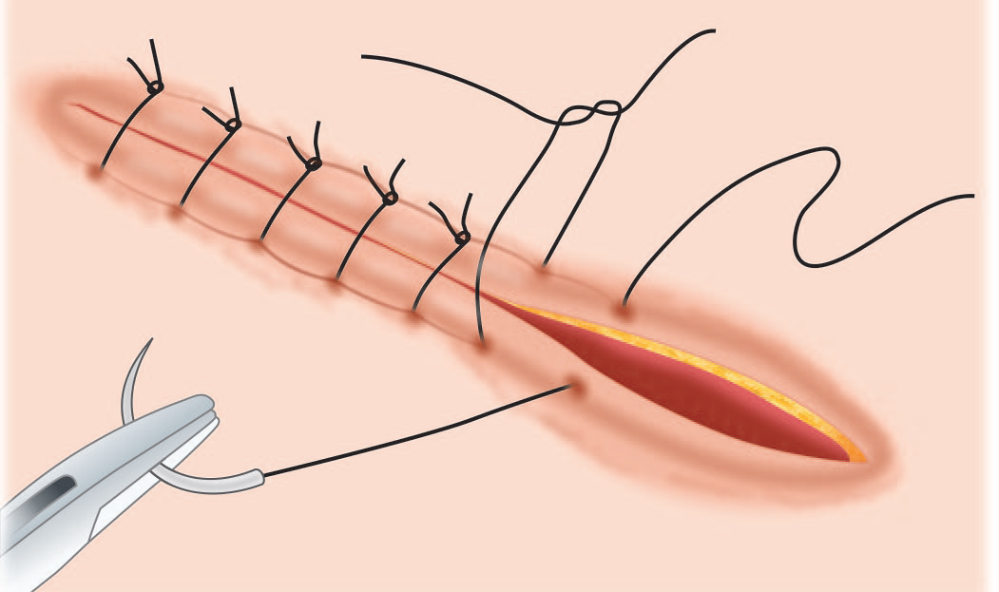
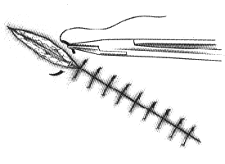
Simple Interrupted
Simple Interrupted Suture

Slide 43
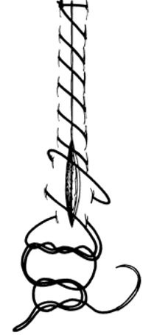
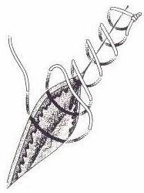
Simple Continuous

Slide 44
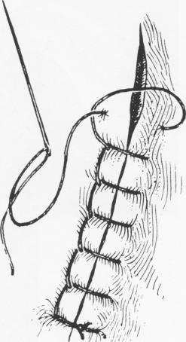
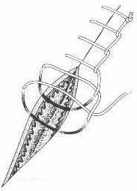
Ford Interlocking

Slide 45
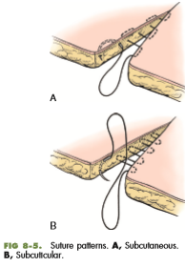
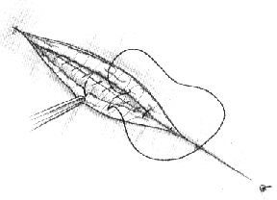
Subcuticular VS Subcutaneous

