Slide 1
The Major Histocompatibility Complex (MHC)
Dr. Balsam miri

Slide 2
Antigen-presenting cells use receptors called MHC molecules to bind and present antigens.
These MHC molecules are responsible for determining if a molecule is histocompatible with the individual and for initiating an immune response if it is foreign.

Slide 3
• MHC molecules are encoded by genes located within the major histocompatibility complex.
Multiple genes code for different parts of the molecules and several possible combinations of gene products exist.
As a result, the chance of two individuals expressing identical MHC molecules is low.
Clinically, MHC molecules are significant as they are the principle mediators involved in transplant rejection.

Slide 4
• Class I MHC molecules are found on all nucleated cells. Their function is to present endogenous antigens to CD8+ T cells.
• Class II MHC molecules are largely restricted to professional antigen-presenting cells such as dendritic cells, macrophages, and B cells. Their function is to present exogenous antigens to CD4+ T cells.
• The class III region of the MHC contains a mixture of genes, some of which encode complement components.

Slide 5
These antigen-presenting receptors are glycoproteins encoded by genes located in a large gene cluster called the major histocompatibility complex (MHC).
The receptors are therefore called MHC molecules.
Antigen fragments can trigger an immune response only after they have bound to MHC molecules, and these antigen-MHC complexes have bound to T cell antigen receptors.
Since the MHC molecules serve as specific antigen receptors, MHC genes determine which antigens can trigger adaptive immunity.

Slide 6
All vertebrates possess cell-surface proteins coded for by genes clustered within an MHC.
Each MHC has a fairly consistent structure consisting of about 200 expressed genes distributed over DNA and divided into three regions containing different classes of MHC gene loci (I, II, and III)

Slide 7
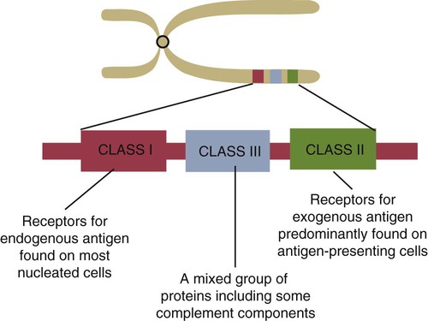
.

Slide 8
Classical class I loci code for the MHC molecules expressed on most nucleated cells. Class I genes can be subdivided into those that are highly polymorphic (class Ia genes) and those that show very little polymorphism (class Ib, Ic, or Id genes). (Polymorphism refers to structural variations between proteins.)
Genes in class II loci, on the other hand, encode polymorphic MHC molecules mainly restricted to professional antigen-presenting cells (dendritic cells, macrophages, and B cells).

Slide 9
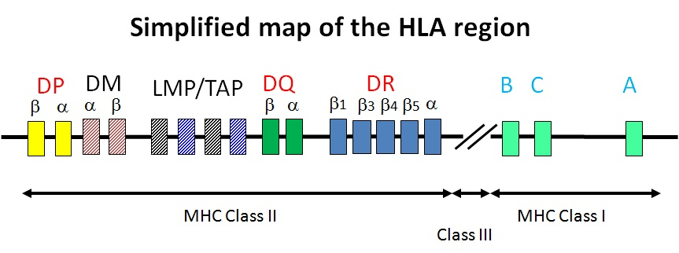

Slide 10
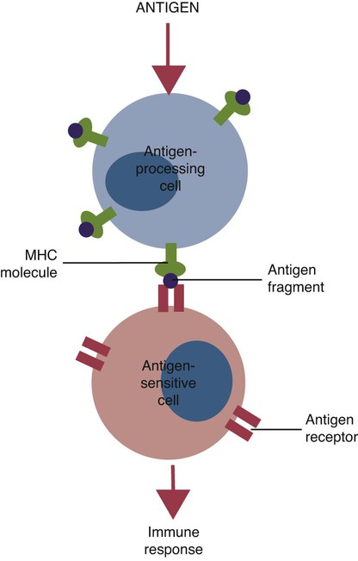
.
.

Slide 11
Although each MHC contains all three gene regions, their gene content, and arrangement vary between species.
The collective name given to the proteins encoded by MHC genes depends on the species.
In humans these molecules are called human leukocyte antigen (HLA); in dogs they are called DLA; in rabbits, RLA; in cattle (bovines), BoLA; in horses, ELA; in swine, SLA; and so forth.
In some species, MHC molecules were identified as transplantation antigens before their true function was recognized.
The complete set of alleles found within an individual animal’s MHC is called its MHC haplotype

Slide 12
MHC Class Ia Molecules
Class Ia molecules are expressed on most nucleated cells.
In pigs, for example, class I molecules have been detected on lymphocytes, platelets, granulocytes, hepatocytes, kidney cells, and sperm.
They are not usually found on mammalian red cells, gametes, neurons, or trophoblast cells.
Some cells, such as myocardium and skeletal muscle, may express very few class Ia molecules.

Slide 13
Structure
Class Ia molecules consist of two linked glycoprotein chains.
An α chain (45 kDa) is associated with a much smaller chain called β2-microglobulin (β2M) (12 kDa).
The α chain is inserted in the cell membrane .
It consists of five domains: three extracellular domains called α1, α2, and α3, each about 100 amino acids long; a transmembrane domain; and a cytoplasmic domain.
The antigen-binding site on these molecules is formed by the α1 and α2 domains.
β2M consists of a single domain and serves to stabilize the structure.
The α1 and α2 domains of MHC class I molecules fold together to form an open-ended groove. A flat β sheet forms the floor of this groove, and its walls are formed by two α helices.
This groove binds antigenic peptides, 8 to 10 amino acids in size. The variable regions located along the walls of this groove determine its shape.

Slide 14
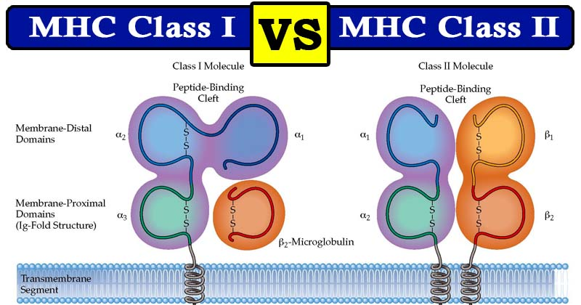
.
.

Slide 15
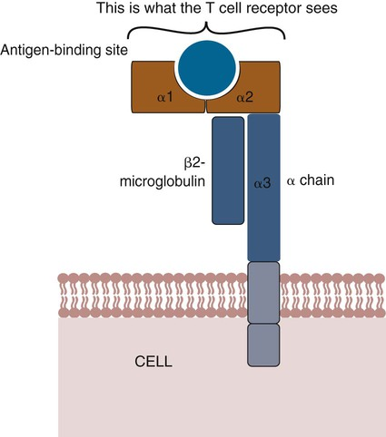

Slide 16
Gene Arrangement
The size of the MHC class I region varies among mammals.
Humans and rodents have the largest, and pigs have the smallest.
The number of class Ia gene loci varies between mammals.
For example, rats have more than 60, mice have about 30, humans have 20, cattle have 13 to 15, and pigs have 11.
Not all these genes are functional. For example, in mice, only two or three class I \genes are expressed. The remainder are pseudogenes (defective genes that cannot be expressed).

Slide 17
Polymorphism
Some class Ia loci encode proteins with very large numbers of alleles.
These allelic differences cause variations in the amino acid sequences of the α1 and α2 domains.
This variation is called polymorphism.
The amino acid variability in the α1 and α2 domains results from variations in the nucleotide sequences between MHC alleles.

Slide 18
Nonpolymorphic MHC Class I Molecules
Mammalian cells also express many nonpolymorphic class I molecules. Some are encoded by genes within the MHC class I region, others by genes on other chromosomes. Class Ib molecules show reduced expression and tissue distribution compared with class Ia molecules but are part of the MHC complex. They have limited polymorphism and their genes probably originated from class Ia precursors by gene duplication. These also consist of a membrane-bound α chain associated with β2-microglobulin, so their overall shape and antigen-binding groove are similar to those in MHC class Ia molecules. Since they are not polymorphic, MHC class Ib molecules bind a limited range of ligands. Thus they are receptors for commonly encountered, microbial pathogen-associated molecular patterns (PAMPs).

Slide 19
Class Ic genes have limited polymorphism and are found within the MHC. Their products include MICA and MICB, specialized proteins that are involved in signaling to natural killer (NK) cells but do not bind antigenic peptides.
Class Id genes are nonpolymorphic class I–related genes not located on the MHC chromosome. Many of their products contribute to innate immunity since they bind PAMPs. For example, CD1 molecules bind bacterial lipids.

Slide 20
MHC Class II Molecules
Mammals differ in their expression of MHC class II molecules. In rodents, they are restricted to the professional antigen- presenting cells (dendritic cells, macrophages, and B cells) but can be induced on T cells, keratinocytes, and vascular endothelial cells. Resting mouse T cells do not express MHC class II molecules,
but in pigs, dogs, cats, mink, and horses, the MHC class II molecules are constitutively expressed on nearly all resting adult T cells.
In cattle, most MHC class II molecules are expressed only on B cells and activated T cells. In pigs, resting T cells express MHC class II molecules at about the same level as macrophages.
In humans and pigs, MHC class II molecules are expressed on renal vascular endothelium an glomeruli—a fact of significance in kidney graft rejection.

Slide 21
Structure
MHC class II molecules consist of two chains called α and β.
Each chain has two extracellular domains (one constant and one variable), a connecting peptide, a transmembrane domain, and a cytoplasmic domain

Slide 22
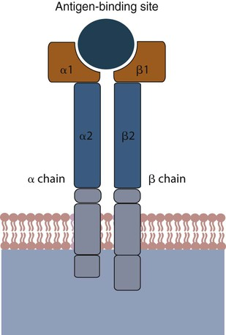
.

Slide 23
Gene Arrangement
A “complete” MHC class II region contains three paired loci.
In primates, these are DPA and DPB, DQA and DQB, and DRA and DRB.
(The genes for the α chains are designated A, and the genes for the β chains are called B.)
Some of these genes are polymorphic.

Slide 24
Polymorphism
MHC class II proteins have an antigen-binding groove formed by their α1 and β1 domains.
Its walls are formed by two parallel α helices, and its floor consists of a β sheet.
Gene polymorphism results in variations in the amino acids forming the sides of the groove.
These variations are generated in the same way as class Ia molecules.
Other genes located in the class II region code for molecules involved in antigen-processing.

Slide 25
MHC Class III Molecules
The remaining genes within the MHC are located within the class III region.
They code for proteins with many different functions.
Some are important in the defense of the body such as the genes for the complement components C4, factor B, and C2.
They also include genes that encode tumor necrosis factor-α (TNF-α), several lymphotoxins, and some NK cell receptors.

Slide 26
Antigen processing, Presentation and MHC- association
Antigen processing and presentation are processes that occur within a cell that result in fragmentation (proteolysis) of proteins, association of the fragments with MHC molecules, and expression of the peptide-MHC molecules at the cell surface where they can be recognized by the T cell receptor on a T cell.
However, the path leading to the association of protein fragments with MHC molecules differs for class I and class II MHC.
MHC class I molecules present degradation products derived from intracellular (endogenous) proteins in the cytosol.
MHC class II molecules present fragments derived from extracellular (exogenous) proteins that are located in an intracellular compartment.

Slide 27
1-MHC class I pathway - All nucleated cells express class I MHC. As shown in Figure below, proteins are fragmented in the cytosol by proteosomes (a complex of proteins having proteolytic activity) or by other proteases.
The fragments are then transported across the membrane of the endoplasmic reticulum by transporter proteins.
Synthesis and assembly of class I heavy chain and beta 2 microglobulin occurs in the endoplasmic reticulum.
Within the endoplasmic reticulum, the MHC class I heavy chain, beta2microglobulin and peptide form a stable complex that is transported to the cell surface.

Slide 28
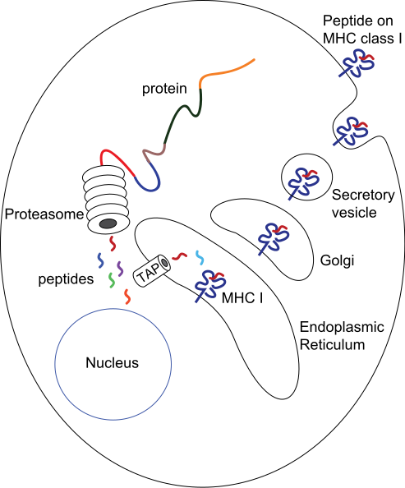
.

Slide 29
2-MHC class II pathway - Whereas all nucleated cells express class I MHC, only a limited group of cells express class II MHC, which includes the antigen presenting cells (APC).
The principal APC are macrophages, dendritic cells (Langerhans cells), and B cells.
As shown in Figure 2, exogenous proteins taken in by endocytosis are fragmented by proteases in an endosome.
The alpha and beta chains of MHC class II, along with an invariant chain, are synthesized, assembled in the endoplasmic reticulum, and transported through the Golgi and trans-Golgi apparatus to reach the endosome, where the invariant chain is digested, and the peptide fragments from the exogenous protein are able to associate with the class II MHC molecules, which are finally transported to the cell surface.
) Invariant chain prevent the premature peptide binding)

Slide 30
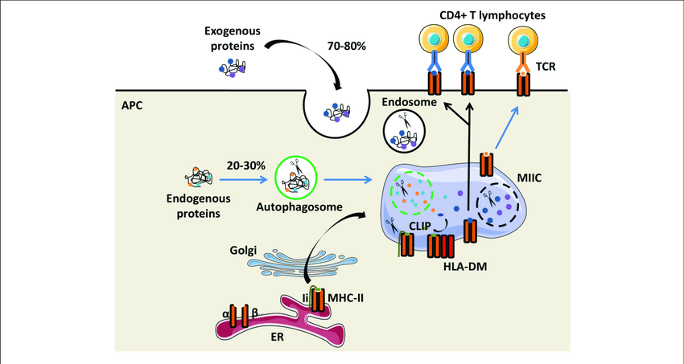

Slide 31
Table 1 : Comparison of MHC Class I and Class I Structure
Feature | CLASS I | CLASS II
Loci include | Typically A, B, and C | DP, DQ, and DR,
Distribution | Most nucleated cells | B cells, macrophages, and dendritic cells
Function | Present antigen to cytotoxic T cells | Present antigen to T helper cells
Result | T-cell–mediated toxicity | T-cell–mediated help
Binds protein antigens of | 8-10 amino acids residues | 12-20 amino acids residues
Antigen binding domain | α1and α2 domains | α₁ and β₁ domains

