Slide 1
Affection of the abdominal wall
Affection of the abdomen :
CONGENITAL & ACQUIRED
1- Congenital abnormalities :
Congenital hypoplasia:
Hypoplasia of the rectus abdominis muscles it is very common in small breeds of dogs like poodles and Pekingese. It is vary in degree and in severe cases there is total absence of the muscle

Slide 2
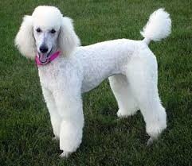
Pekingese poodles

Slide 3
2- Acquired lesions
1-Acute abdomen ( colic ) : refers to the sudden onset abdominal pain:
True –when the pain arises from the GIT.
False when the pain arises from other system in the abdominal cavity.
Causes are usually an acute generalized disease gastrointestinal obstruction, neoplasia, or a disorder of the urogenital tract.
Acute abdominal pain should be considered as a disease that need surgical correction , until proved the reverse? If the pain lasts more than 6hrs it is usually has surgical significance.

Slide 4
There are two types of causes:
The cause –either medical cause –such as –acute pancreatitis, acute renal disease , acute gastroenteritis , acute prostatic disease , acute hepatic disease , and peritonitis.
The causes –which have surgical nature (need surgical intervention ). Such as rupture of the urinary bladder , urethral obstruction, intestinal obstruction, rupture of the spleen, liver , or kidney.

Slide 5
Clinical sings :
in dogs, include pain , emesis, diarrhea, abdominal distention, and shock.
In horse –restless and anxiety , stamping the hind feet , kicking toward the abdomen , look to the abdomen and to the site of most intense pain , suddenly roll on the ground profused sweating , grinding of teeth , and increase respiration and nostril dilated , and increase pulse, temperature normal.
Diagnosis : History.
Treatment : depend on the diagnosis, shock should be treated immediately.

Slide 6
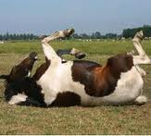
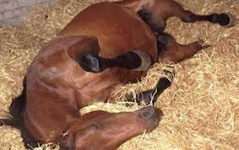
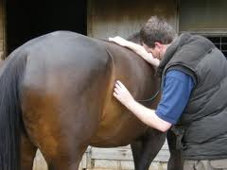

Slide 7
3-Trauma of the abdominal wall ( contusion )
Classification:
Non-penetrating trauma result in weak spot in the wall which predispose for hernia or may cause rupture of vascular or hollow organs.
Penetrating ( perforating ) wound, it caused by sharp object, stabbing , or gunshot. It can classify into :
A-perforating wound without injury of the abdominal organs. Treat by antibiotic , and suturing of wound when there is no infection.

Slide 8
B-perforating wounds with trauma to abdominal organ (have poor prognosis ), in some cases there is fistula treated by laparotomy removal of adhesion and repair of intestinal wound .
C-perforating wounds with prolapsed of organs without trauma. This is usually occurs following laparotomy treated by washing of intestine by warm normal saline and reposition of the intestine and repair the wound.

Slide 9
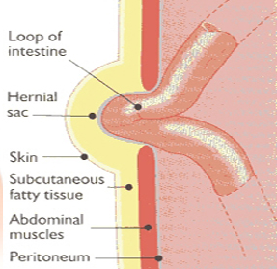
Hernia
Hernia is abnormal protrusion of an organ or tissue through a normal or abnormal opening in the abdominal muscle or in the diaphragm. It may be congenital or acquired.
classically hernia consists of three parts:
1- hernial sac.
2- hernial contents.
3- hernial ring.

Slide 10
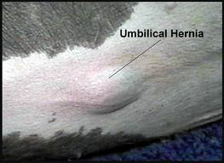
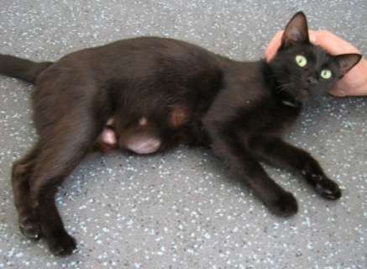
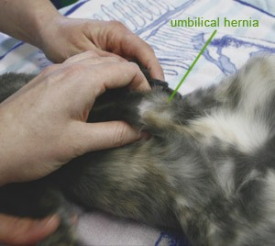
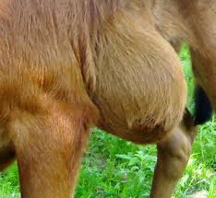
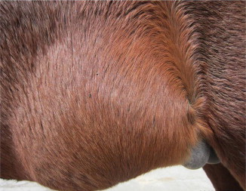
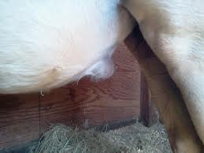

Slide 11
Hernia –can be classified according to :
A- The condition
1-reducible.
2-irreducible.
3-strangulated.

Slide 12
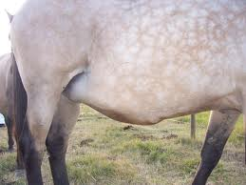
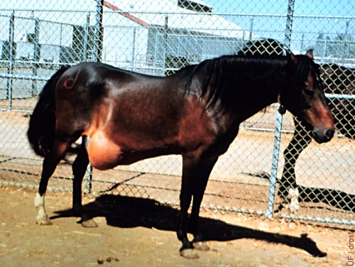
B-according to the location : such as –umbilical, ventral ,scrotal , inguinal , diaphragmatic and perineal hernias.
C- according to the contents : such as enterocoele, omentocele, gastrocele, metrocele, vesicocele.
D- according to the cause –inherited , traumatic, incisional.

Slide 13
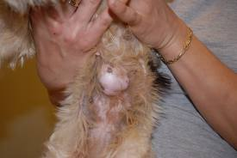
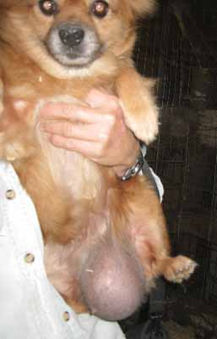
1-Umbilical hernia:
Protrusion of omentum , fat with falciform ligament , part of organ ( intestine ) through an opened umbilical ring.
Hernia of the umbilical cord , the viscera
pass through the abdominal wall through
a dilated umbilical cord , and are not
covered with peritoneum.

Slide 14
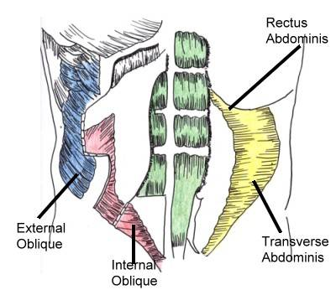
Umbilical hernia are common in domestic animals , may be congenital: It result from failure or poor to fully develop of abdominal muscles surrounded the hernia.
or acquired :such as the umbilicus may weakened or enlarged, and if the cord is cut too close to the abdominal wall , or if the bitch chews the cord, or careless handling the umbilical cord during cesarean section .

Slide 15
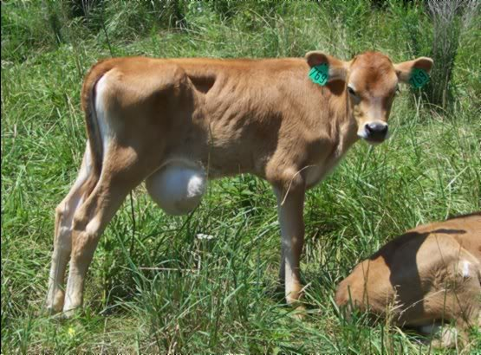
CL. Signs: obvious protrusion on the ventral abdominal wall the size of the hernial sac and ring is vary, palpation reveals a soft fluctuating painless mass, reducible, or irreducible.
D.D. : Cellulitis , abscess formation. Abscessation in the umbilicus must be differentiated from hernia by needle aspiration , also should be differentiated from infected urachus.

Slide 16
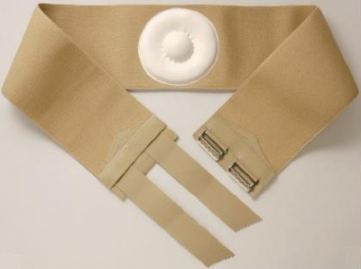
Treatment :
Application of pressure bandage after putting an hard object at the ring of hernia , this is useful in small hernia – in young animal.
Injection of counterirritant , on the surface of hernial sac or around the hernial ring ?.

Slide 17
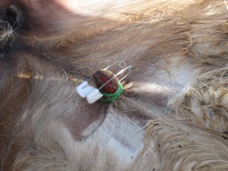
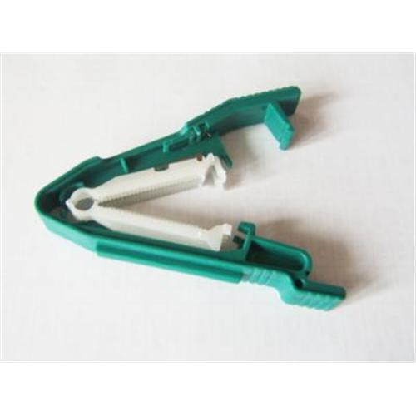
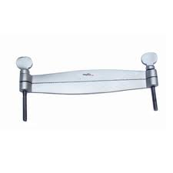
Application of hernial clamps , either metal or wooden , placed across the hernial sac after returned the hernial content to the abdominal cavity .
Ligature of the hernial sac ( after put metal skewers) the ligature by simple mattress suture or purse –string suture ( heavy ligature was applied between the skewers and the body wall in order to cause necrosis of the sac).

Slide 18
By open reduction of the hernia.
general anesthesia in horses and small animals and under high volume scrococcygeal.
The animal put on dorsal recumbency.
Make skin incision (or two elliptical incision) over the hernia, isolation the sac by dissection , removal of the sac and return of the content and peritoneum ).
Close of the abdominal muscle by modified mattress suture ( modified mayo closure " vest –over pants ") is used with size 2 or 3 absorbable suture material or non-absorbable suture material.
Then closure of skin by usual mannar and remove the excessive skin. When the hernial ring is too large , use of metallic or synthetic fiber mesh prosthesis to cover the defect in the abdominal wall.

Slide 19
Umbilical hernia in male animals:
Make two elliptical incision on the hernial sac which joined from above and extended parallel to the prepuce and not joined , then make inverted U-shape incision before and around the prepuce and joining the caudal ends of the elliptical incision after suturing this type of incision will become inverted Y-shape skin incision .

Slide 20
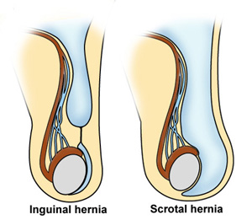
2-Inguinal hernia :
Seen in most of the domestic animals , characterized by protrusion of intestine or other viscera (omentum, uterus) through the inguinal canal. If the organs reach to the scrotum then its called as scrotal hernia.

Slide 21
They are more common in bitches , (pregnant or old bitches) due to increase the intra-abdominal pressure .
Inguinal hernia –in equines –more common in stallion but has also been reported in castrated animals.

Slide 22
Causes
either its congenital (hereditary predisposition), when increase the intra-abdominal pressure with pregnancy , or even obesity can be predisposing factor.
or acquired -----

Slide 23
Clinical sings
In small animals ( dog and cat ) characterized by protrusion of abdominal content near the inguinal canal.
It is usually unilateral but bilateral also be seen.
The hernial content usually soft , doughy and painless on palpation. The consistency is vary according to the contents. The swelling may so small, obscured by caudal mammary gland , or large enough to contents a gravid uterus.
In horse –the animal shows pain just after serves.

Slide 24
Diagnosis
By the history.
Per-rectal examination in large animals.
In small animal, determination of the location of the hernial ring after reduction of the contents assisted by elevation of hind quarter while the animal in dorsal recumbency. in some cases when there is incarceration or strangulation , the reduction may be difficult. It must be differentiated from mammary tumor, abscess, cyst and hematoma.

Slide 25
Treatment
In bitch skin midline incision is made from middle of abdomen to the pubis.
Blunt dissection with the reflection of the mammary gland until reach the inguinal canal, free the herinal sac from the subcutaneous tissue.
Open the sac, reduce the hernial content to the abdominal cavity, trimming the redundant sac at the margins of the inguinal ring, and close the inguinal ring by simple interrupted suture with 2/0 non absorbable suture material, care should be taken not compromising the external pudendal artery and genitofemoral nerve which exit from the caudomedial aspect of the ring. The mammary tissue drawn back to normal position, obliterate the dead space, put Penrose drain. Close the skin routinely.

Slide 26
In male animals it can be done with or without castration .
Without castration –for highly expensive animals. Surgery –must be done under general anesthesia.
Make incision over the inguinal canal , free the herinal sac, reduce the content –into the abdominal cavity , then close the internal inguinal ring.
Put purse string suture as far high as possible around the tunica vaginalis leaving room for the passage of the spermatic cord (not compromising the spermatic cord).
Close the skin as usual. prevent the animal from serves 6-8 months.

Slide 27
With castration –After reduce the hernial content to the abdominal cavity, double ligate the spermatic cord, sever the cord between the ligatures, remove the testes, then reduce the stump of the cord to the abdominal cavity, and suture the inguinal canal.

Slide 28
3-Scrotal hernia:
More common in rams and bulls but its rare in dogs , characterized by unilateral enlargement of the scrotum, the contained may reduced through the inguinal canal when put the animal on dorsal recumbency and with elevation of the hind limb.
The causes may be either congenital or acquired.
Treatment can be done with castration or without castration.

Slide 29
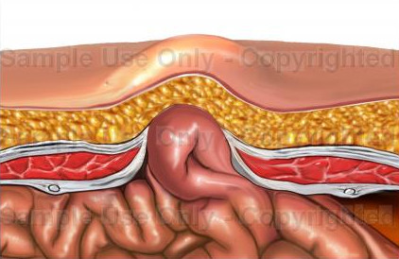
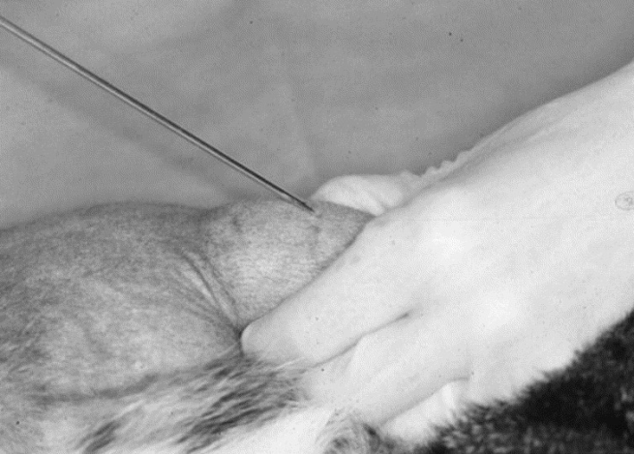
4-Ventral hernia
When there is prolapsed of abdominal content through the abdominal wall , at any point other than the umbilical or inguinal ring. This hernia is usually acquired after trauma (kicking ) or struck by a car , horn trauma or any contact with blunt object. Its has been described as false hernia the occurrence in small animals ( dogs and cats ) in the flank region , near the pelvis.
In the large animal the common sites are high or low in the flank , along the costal arch, or between the last few ribs. They may be also occur on the midline and the area of prepubic tendon .

Slide 30
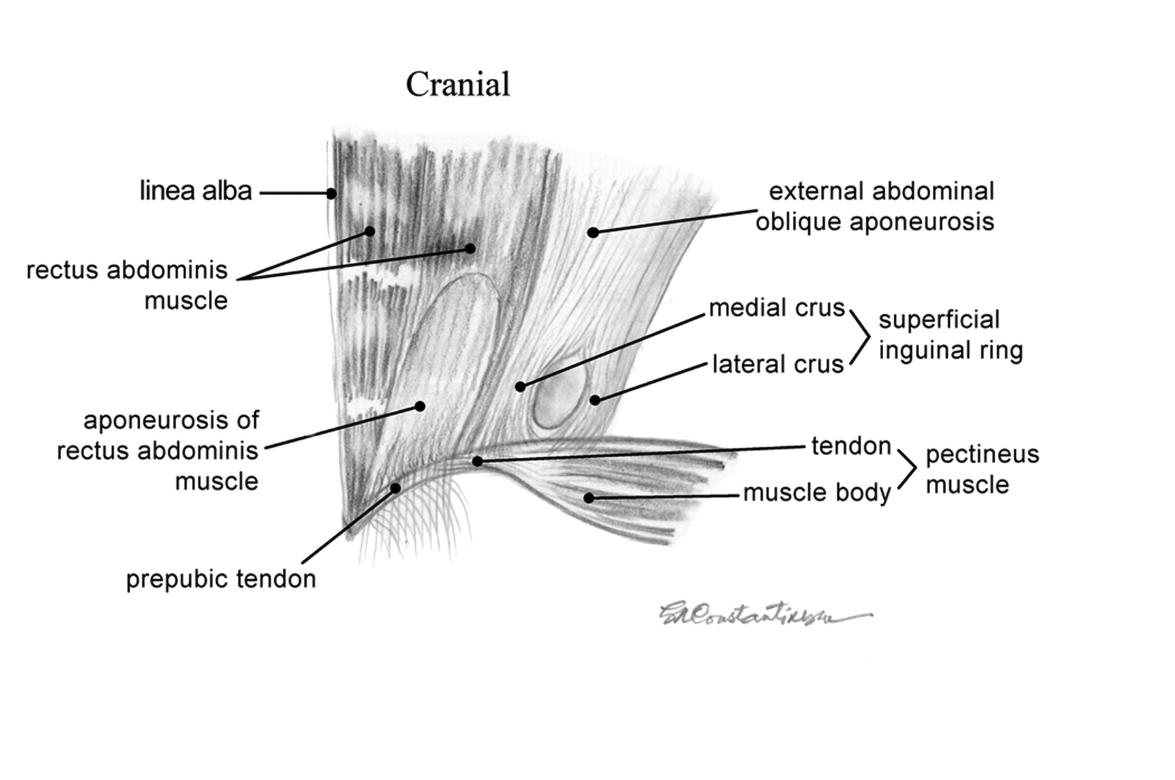

Slide 31
Clinical sings
Swelling in the abdominal area and the consistency of the swelling and develop depended on the content and presence or absence of infection , the size of the swelling may increase following sudden movement or during coughing.
There is may be a signs such as shock , internal hemorrhage etc.
Diagnosis : by palpation to found the hernial ring if the swelling is reducible –the content is reduced and the ring can be felt.
If its irreducible , due to adhesion or incarceration. It should be differentiated from abscess, heamatoma , cyst or neoplasm.

Slide 32
Treatment
Treat the shock or internal hemorrhage firstly , if present ; repair the hernia by open method by general or local anesthesia , make incision free the content, reduced , then suture the muscle( vest over pant) a modified mayo closure , obliterate dead space then close the skin by ( routine skin closure ).

Slide 33
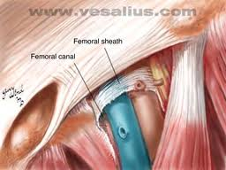
5-Femoral hernia
Its rare , but has been reported in small animals , it should be differentiated from inguinal hernia. It characterized by present of the swelling on the medial aspect of the thigh ( herniation of the abdominal content in the femoral canal ).

Slide 34
Diagnosis
Made by the present of an enlargement in the femoral canal on the medial side of the thigh .
Treatment : as in inguinal hernia

Slide 35
6-Perineal hernia
Its common in small animal, rather than large animals , it differs from other hernia is that the abdomen organs, usually are not covered with a peritoneal sac but if the peritoneum is present its degenerated.

Slide 36
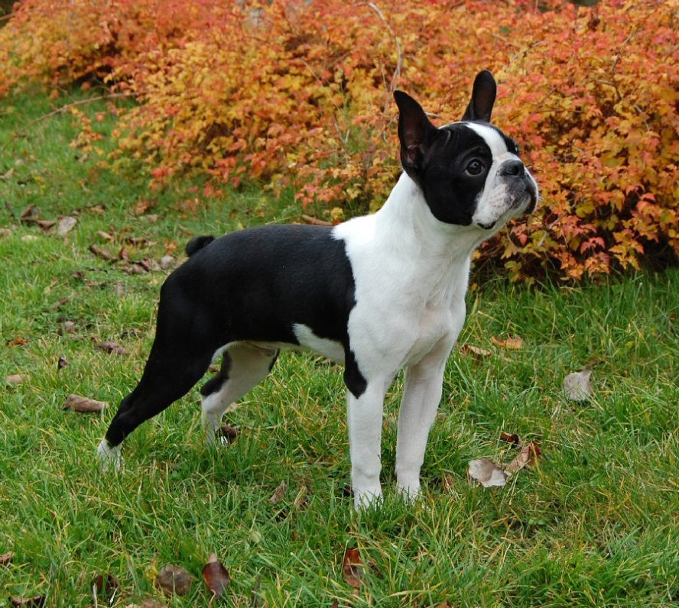
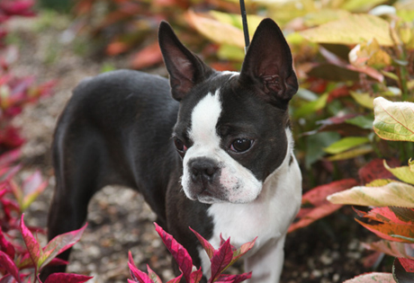
Causes : specific cause are unknown but it mainly and attributed to failure or weakness of the fascia and muscle of perineum , prolapsed in abdominal or pelvic organs into the space created by atrophy or injury of the pelvic. Its reported in male more than female , in old more than young. Also in dogs with rudimentary tails such as Boston Terriers. Endocrine imbalance are another cause because this hernia found in animals have testicular tumor, and prostatic enlargement. Constipation –also another cause .

Slide 37
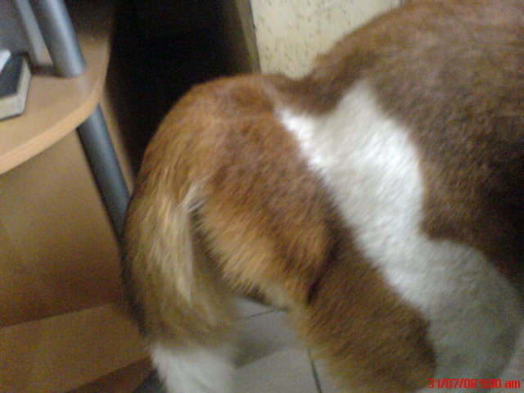
Clinical signs
1-straining during defecation .
2-present of swelling lateral and extended ventral to the anus. The swelling is soft and fluctuating and manipulation often results in reduction of the content if the urinary bladder and prostate gland are the hernial contents. The swelling may be turgid also if may be bilateral and in this case the anus is displaced caudally .

Slide 38
Diagnosis
1- by the signs .
2-by the palpation of the content.
3-pushed back into the pelvic cavity.
4-lifting the hind limb.
5-by digital exam. from the rectum also help.

Slide 39
Treatment
1-put the animal under general anesthesia .
2- if the bladder is herniated , try to evacuated it by catheterization. Then reduce the content.
3- after make incision ( slightly curve over the hernia)open the hernial sac ( thin band of fascia and fibrous tissue).
4-replaced the herniated organs , into the pelvic cavity .
5-suture the muscle with catgut .
6-then suture the skin .

Slide 40
THANK YOU FOR YOUR ATTENTION

