Slide 1
Radiology
Science deals with the use of radiation energy for diagnosis and treatment.
Radiograph: (shadowgraph)(skiagram ) :visible photographic records of X-ray = radiographic film.
Radiography: art and science of taking radiograph.
Radiologist: man who working in radiology.
Radiographer: man who taking radiograph.

Slide 2
X Ray
Definition
It is an electromagnetic radiation of high energy (10³ – 10¹⁰ ev) and low wave length (10 ⁻⁸ - 10⁻¹⁶ m).
History
It is discovered in 1895 by W. Roentgen while doing experiments with electron flow in vacuum tubes, even he made a radiograph to his wife hand.

Slide 3
Properties of X Ray
Travel in straight lines.
Same light speed (186000 mile/sec).
Invisible.
Have penetration power.
Photographic effect.
Biological effect.

Slide 4
X - Ray machine
Portable X-ray machine 70-90kv 5-30mA
Mobile X-ray machine 90 kv 40-60 mA
Fixed X-ray machine 120-200kv 300-1000

Slide 5
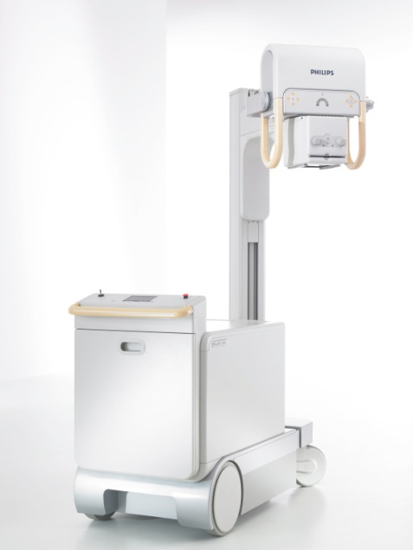
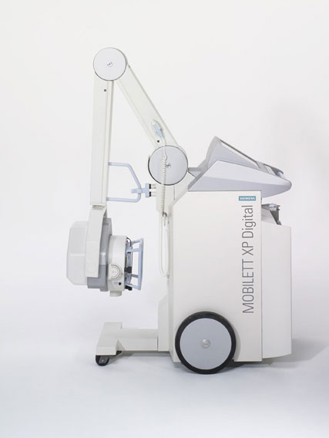
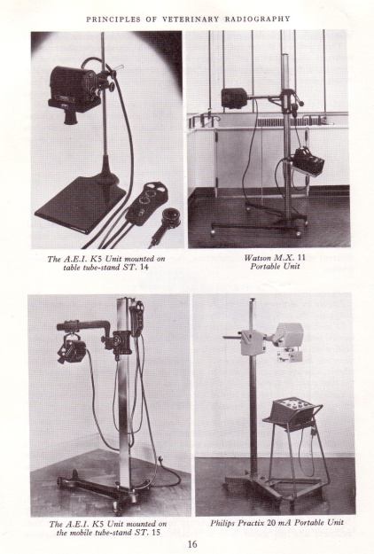
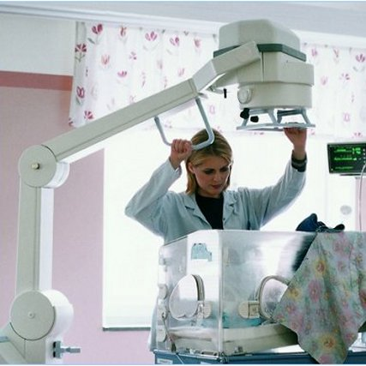
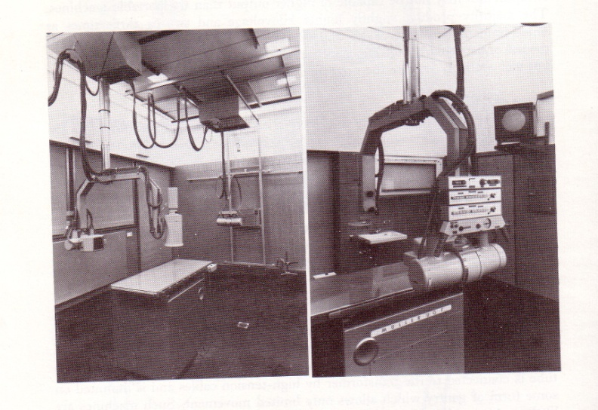
X - Ray machine

Slide 6
The X-ray machine
The x-ray machine is divided into four major components.
The Tube
The Tube Stand
The Transformers
The Control Panel

Slide 7
Types of X- ray
Soft X- ray: long wave length and low penetration power.
Hard X- ray: short wave length and high penetration power.

Slide 8
Radiographic accessories
Cassettes.
Intensifying screen.
Films.
Dark room: (dry bench, wet bench, viewer, safe light, dryer and hangers)

Slide 9
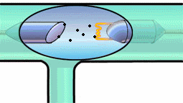
Production of X-rays
X-rays are produced when rapidly moving electrons that have been accelerated through a potential difference which strikes a metal target.
Evacuated
glass tube
Target
Filament

Slide 10
Production of X-rays

Slide 11
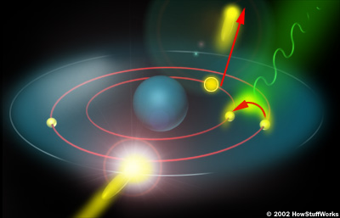
Production of X-rays (2)
Electrons from a hot element are accelerated onto a target anode.
Less than 1 % of the energy supplied is converted into X-radiation during this process.
The rest is converted into the internal energy of the target.

Slide 12
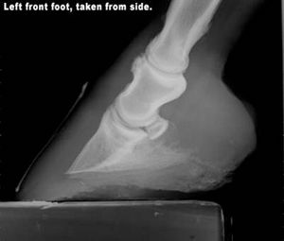
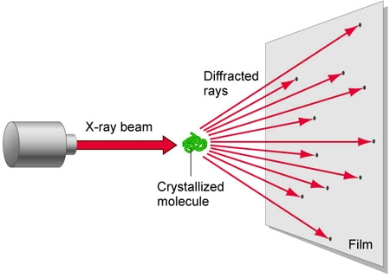
Uses of X-rays
In medicine
To diagnose illness and for treatment.
In industry
To locate cracks in metals.
X-ray crystallography
To explore the structure
of materials.

Slide 13
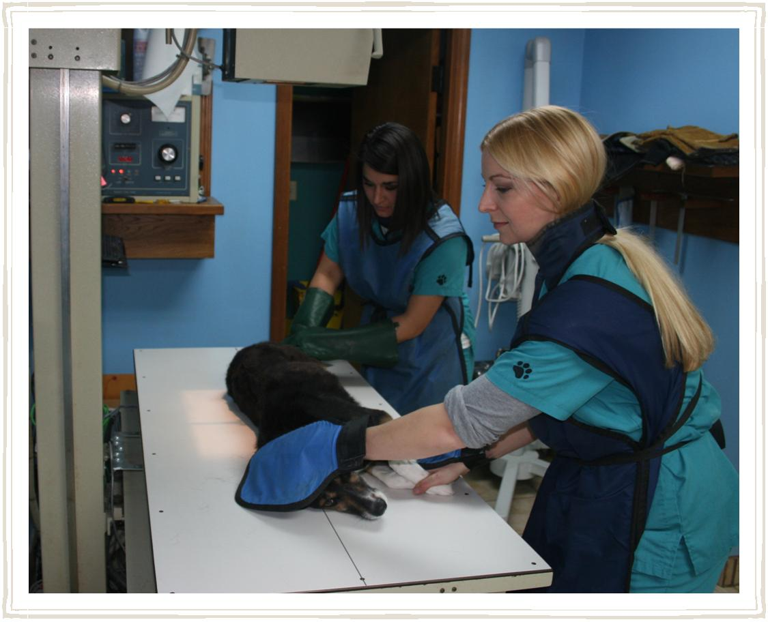
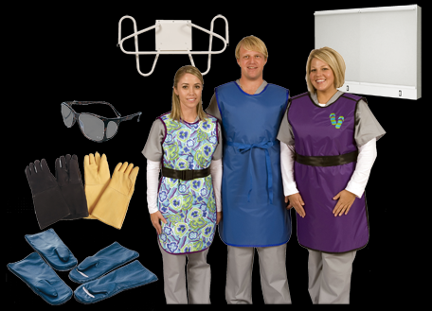
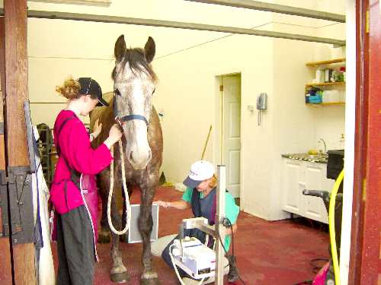

Slide 14
X-ray Room
Floor mounted x-ray tube stand.
Wall grid cabinet
Mobile Table with grid cabinet (optional)
Film Holder (optional)

Slide 15
X-ray Room
Control Booth should contain the operator console and technique charts and space to store cassettes.
The wall between the booth and X-ray unit is shielded.

Slide 16
X-ray Room
High Voltage Section or Generator used to change incoming power to levels needed to produce x-rays.

Slide 17
The X-Ray Tube Glass Envelope
The glass envelope is made of Pyrex.
The window is a 5 cm square with a thin section of glass where the useful beam is emitted.

Slide 18
The Cathode
The cathode is the negative side of the tube and contains two primary parts:
The filaments
The focusing cup

Slide 19
The Filaments
Most tube have two filaments which provide a choice of quick exposures or high resolution.
The filaments are made of tungsten.

Slide 20
The Filaments
Tungsten is used in x-ray tube because of it’s high melting point of 3410°C.

Slide 21
Focusing Cup
The focusing cup has a negative charge so that it can condense the electron beam to a small area of the anode.

Slide 22
Filament Current
When the x-ray machine is turned on, a low current flows through the filament to warm it and prepare it for x-ray production.

Slide 23
The Anode
The anode is the positive side of the tube.
X-ray tubes are classified by the type of anode:
Stationary ( top)
Rotating (bottom)

Slide 24
The Stationary Anode
Stationary anodes are used in dental x-ray and some portable x-ray machines where high tube current and power are not required.

Slide 25
The Rotating Anode
The rotating anode allows the electron beam to interact with a much larger target area.
The heat is not confined to a small area.

Slide 26
The Rotating Anode
The Anode must also be a good thermal conductor.
When the electron beam strikes the anode more than 99% of the kinetic energy is converted to heat.

Slide 27
The Rotating Anode
Tungsten is used as the target for the electron beam.
Tungsten is used for two reasons
High atomic number
High melting point..

Slide 28
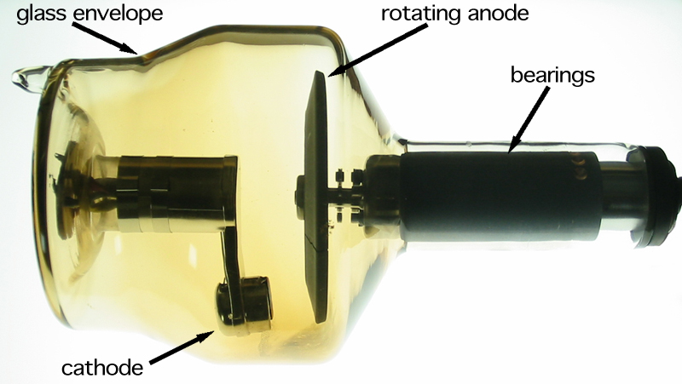
The Rotating Anode
The rotor is an electromagnetic induction motor.
It spins at 3400 rpm.
High speed anodes spin at 10,000 rpm.

Slide 29
Processing of X-ray film
Film: is polyester plastic base coated both sides with thin layers of emulsion consist from silver halide (silver bromide) which is sensitive to X-ray and light.
Processing tanks are:
Developer.
Rinses.
Fixer.
Washing and drying.

Slide 30
Processing of X-ray film
Developer: convert silver ions to minute grains of metallic silver which take the black color in 3 – 5 minutes.
Fixer: dissolve the unexposed halide and harden the gelatin in 10 minutes.
Washing at least 15 minuets and drying.

Slide 31
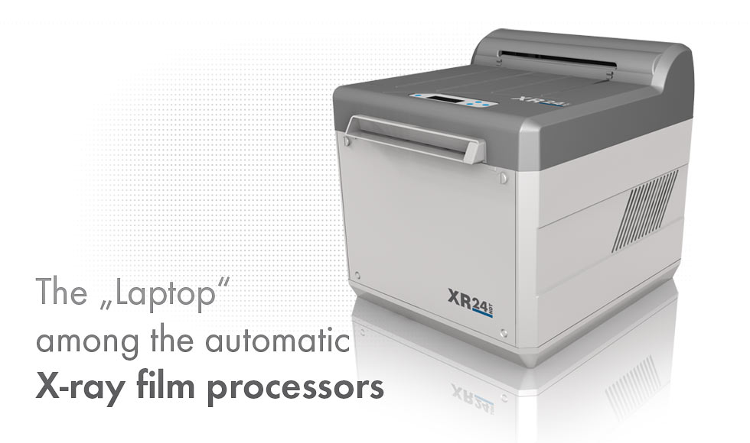
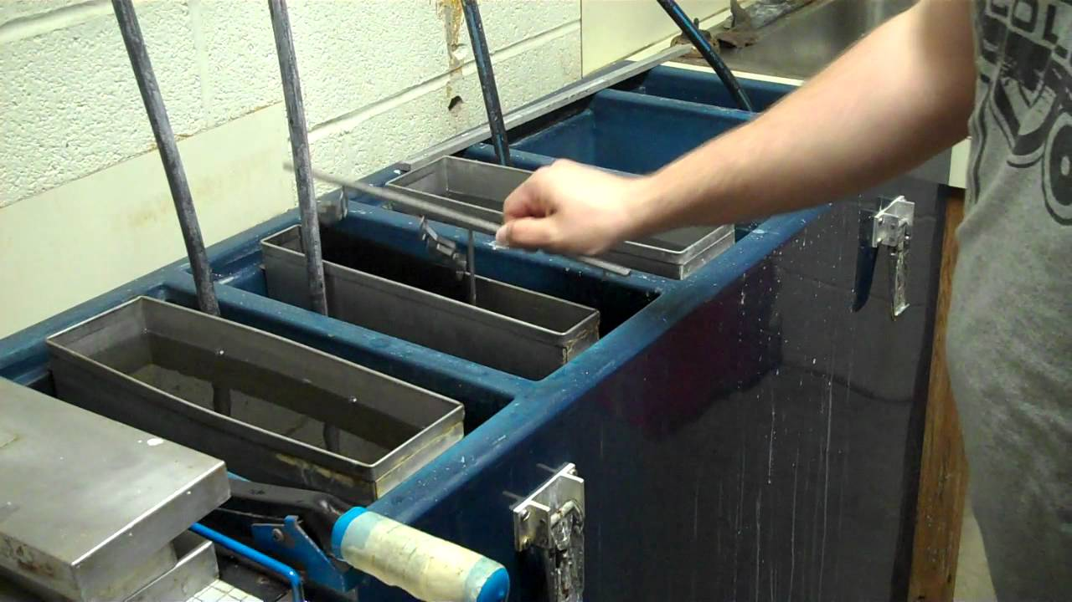
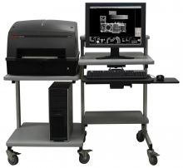
Processing of X-ray film

Slide 32
Properties of Radiograph
Good quality radiograph depends on accurate positioning , correct exposure factor and good dark room technique.
1- density degree of blackness

Slide 33
There are five radiographic densities can be seen on radiographs :
a- mineral density ( take white color ) b-bone density c-fluid and soft tissue density d-fat density
e-gas ( air ) density ( which take black color ).

Slide 34
2-contrast : ((the difference between two densities ))
factors affect contrast :
a-the organ ( radiopaque or radiolucent ).
b-ma=the quantity of X-ray = ↑ma = ( over exposure )
↓ma= ( low exposure )
c-KV=the quality of X-ray
d-scattered radiation , make blurriness.

Slide 35
3- Details : = sharpness of the radiographic image
Factors effecting on details :
a-focal spot area –small focal spot area give good details.
b-magnification / or the distance between the body and the film . increase the distance between the body and the film will increase the magnification and loss the details for that (place the part to be radio graphed as near to the film as possible )).

Slide 36
c-F.F.D .(focal film distance )decrease the focal film distance will increase the magnification and vice versa for that we need to increase the F.F.D up to 180cm when the natural distance between the part of the body need to radiograph and the film is too far (like the vertebral column in horse ) the distance –the thickness between vertebrae and film is 30 cm .
e- movement of the animal.
f-processing in the dark room.
g-illuminator (viewer )and the light in viewer .
i- the organ need to be radiographed should be parallel to the film .

Slide 37
Off Focal Radiation
Remember that x-rays are produced in all directions. The electrons can rebound and interact with other areas of the anode.
This is called Off-Focal Radiation.

Slide 38
Prevention of radiation hazard
A diaphragm is placed between the tube and the collimator to reduce off focus rays.

Slide 39
Radiation hazard and prevention :
Somatic effect : the X-ray ionize the tissue and make injury, not all the body tissue in the same sensitivity to the X-ray , the most sensitive is the multiplying cells , such as the blood forming organs (bone marrow, lymphoid tissue, and spleen ), the gonads, embryo---etc.
The nervous system , the bone , are relatively radio-resistance. Mothers and boys below 16 years not allow to help in X-ray.

Slide 40
Genetic effect : the X-ray increase the incidence of mutations when the genital organs are irradiated (increase the number of abnormal births )
The excessive irradiation cause cancer, opacity of the lens and infertility.

Slide 41
Prevention:
1- all the persons involved should be away from the source of X-ray (stand as far as away from the primary beam ) , and the workers wear the apron have 0.5 mm lead, and protective gloves have 0.33 mm lead.
2-restrict the primary beam only on the examined area.
3-use of filter.

Slide 42
4-anesthetize the animal.
5-care should be exercised to not repeat the film.
6-covered the examination table by lead for protection of feet.
7-use of special badges for measuring the amount of body exposure.

Slide 43
Contrast radiography
Using contrast media in radiography.
This media are used to increase visualization of soft tissues which are radiolucent.

Slide 44
Types of contrast media
Barium sulphate : alimentary tract.
Organic iodine preparations : blood vessels, urinary system, brain and biliary system.
Oily agents as Dionosil : lung.

Slide 45
Special procedures in radiology
Esophagography: esophagus.
Sialography: salivary gland.
Pyelography: kidney.
Cystography: urinary bladder.
Cholecystography: gall bladder.
Bronchography: lung and bronchi.
Fasciography: muscle, tendon.
Myelography: spinal cord.
Arthrography: joints.
Peritoneography: peritoneal cavity.

Slide 46
CT scan (computed tomography)
It is a computerized axial tomography scan. The CT scan work by taking multiple X-ray images which are generated by a computer into cross-sectional pictures of the internal organs and structures of the body ( mainly brain ).
The patient put in a donut hole and the X-ray tube rotate around his body to generate hundred of images known as slices , these images are processed by a computer to allow the doctor to see soft tissue structures in great details.

Slide 47
MRI (magnetic resonance imaging)
It is the name indicating utilizing magnetic fields ( instead of x-ray utilized in CT Scan) to provides anatomic image of the soft tissues like brain, cartilage, tendon, muscle, ligament, etc.. The patient lies wholly within a magnetic tunnel and surrounded by a large magnet.

Slide 48
Ultrasound
uses of high –frequency sound wave to produce images of the internal organs and structures of the body. It is a quick method for imaging without the use of radiation.
Using ultrasound waves are sent through the body by a tool called transducer. A gel is applied to the surface of the skin in the area that is to be imaged , and the transducer is placed immediately over it. Internal structures reflect the sound waves emitted by the transducer and displayed on a monitor.

Slide 49
Fluoroscopy
It is one method of image receptor system in which used of fluorescent screen instead of X-ray film, and the X-ray tube which used from the continuous radiation output type, instead of single exposure type.
In the fluoroscopy , the X-ray tube is located under the X-ray table , and the fluorescent screen put above the animal. The fluorescent screen convert the X-ray photons to visible light viewed directly , this technique used to observe the function of the organs.

Slide 50
Image intensification system (IIS )
1- no need dark accommodation of the viewers eye.
2- the examination is done in normal lighting condition.
3-image brightness is produced by electronically multiplying the number of light photons produced.
4-the image is viewed in a mirror or seen on a television monitor.
5- the brightness is obtained electronically rather than by increasing radiation level.
6-the duration of radiation exposure is lower than with fluoroscopy.

Slide 51
THANK YOU FOR JOINING ME

