Slide 1
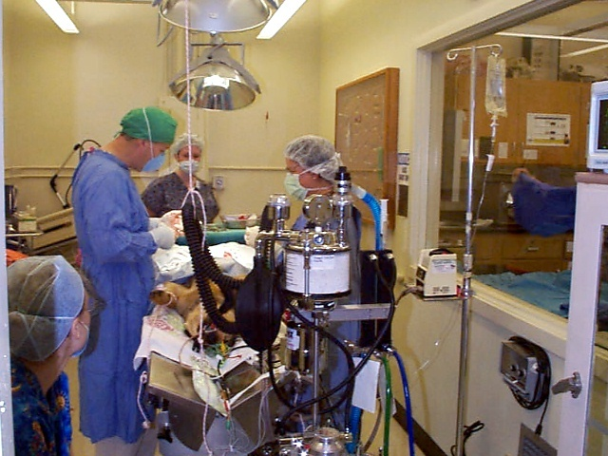
anesthesia

Slide 2
History of Anaesthesia
First use of Anaesthesia in animals since 1846 in Royal Veterinary College by Mortons.
Chloroform was used in Vet. at 1847 and In 1878 used in anaesthesia of horse by Humbert .

Slide 3
Terminology
Anaesthesia: Inability to feel pain.
General anaesthesia: It is a state of unconsciousness produced by a process of controlled, reversible intoxication of the CNS.
Regional anaesthesia : Insensibility in a larger, through limited body area .
Local anaesthesia : Loss of sensation in a limited body area .
Surgical anaesthesia : Unconsciousness , accompanied by muscular relaxation to such a degree that surgery can be performed painlessly and without struggle on the part of the patient.
Preanesthetic drugs : are the drugs which are usually given to prepare the patient for administration of an anesthetic agent .

Slide 4
General anesthesia should involve three effects:
narcosis
Sleep like state
analgesia
Loss of pain
relaxation
Muscle Relaxation

Slide 5
Indication for Use Anesthesia in Animals
Humanitarian .
Technical efficiency , which include:-
surgical procedure.
radiography ( cervical, pelvic, or spinal ).
cast application.
obstetrical procedures.
special diagnostic procedure (e.g) diagnosis of lameness.
in overdose for euthanasia.

Slide 6
selection of the anesthetic methods
Facilities and anesthetic equipment available.
Species of the animal.
The nature , the site , and the duration of the operation.

Slide 7
Factors affecting anesthesia
Age of patient
Size
Temperament
Preanesthetic medication
Type of surgical or diagnostic procedure

Slide 8
The main purposes for use of premedications
Help in restraint of the animal.
Reduce the amount of general anesthetic.
Decrease the side effect of anesthetic drugs.
Prevent vomiting.
have analgesic properties.

Slide 9
Characteristics of Ideal Anesthetic
Rapid induction and rapid recovery.
Wide margin of safety.
Non irritant to tissue.
Non inflammable , non explosive and chemically stable.
Inexpensive.
Produce good relaxation and analgesia.

Slide 10
General anesthetics
volatile
Inhalation
water soluble
i/v injection
i/m injection

Slide 11
Administration of anesthetic agents (IV/Injection)
Horse
Cattle
Pig
Auricular vein
Jugular Vein
Dog
Cat
Cephalic vein or Femoral vein
Sheep
Goat
Jugular vein
Rabbit
Marginal ear vein
Elephant
Ear vein

Slide 12
stages of general anesthesia
Stage of induction.
Stag of Delirium.
Stage of surgical anesthesia.
Plane of light anesthesia.
Plane of medium anesthesia.
Plane of deep anesthesia.
Stage of overdose

Slide 13
COMPLICATIONS OF GENERAL ANAESTHESIA
During anaesthesia
1. Respiratory depression. 2. Salivation.
3. Cardiac arrhythmias. 4. Fall in BP. 5. Aspiration of gastric contents. 6. Asphyxia. 7. Delirium and convulsions. 8. Fire and explosion.
B. After anaesthesia
1. Vomiting. 2. Persisting sedation.
3. Pneumonia, atelectasis. 4. Liver and kidney damage. 5. Nerve paralysis due to faulty positioning.

