Slide 1
OTOLOGY

Slide 2
Complementary Terms
Otology = study of the ear.
• Audiology = study of hearing.
• Audiologist = one who is skilled in and specializes in audiology.
• Otologist = physician who studies and treats diseases of the ear.
• Otorhinolaryngologist = ENT physician who studies and treats diseases and disorders of the (ear, nose, & throat).
OTOLOGY

Slide 3
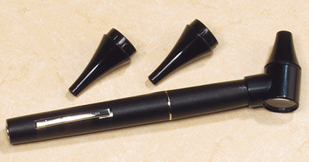
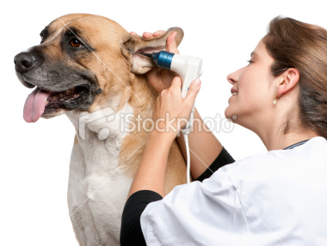
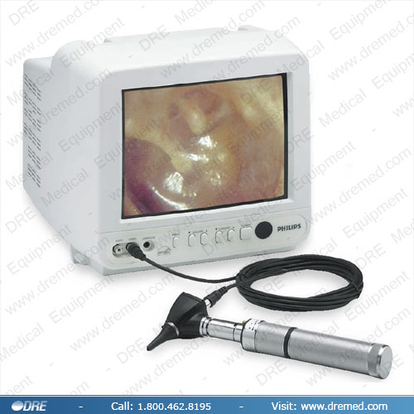
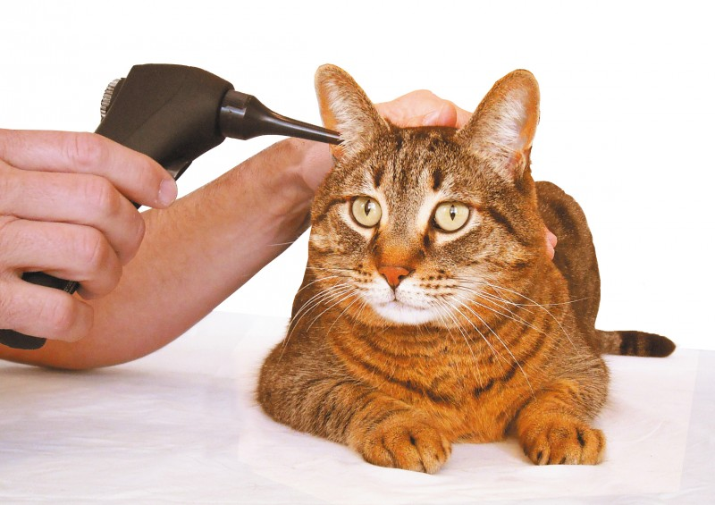
Otoscopy = visual examination of the ear.
OTOLOGY

Slide 4
THE EARS
The ears are paired sensory organs comprising the auditory system, involved in the detection of sound, and the vestibular system, involved with maintaining body balance/ equilibrium.
The ear divides anatomically and functionally into three regions: the external ear, the middle ear, and the inner ear. All three regions are involved in hearing. Only the inner ear functions in the vestibular system.
OTOLOGY

Slide 5
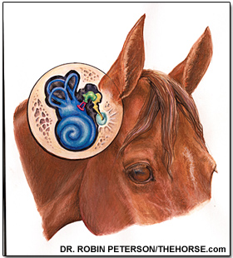
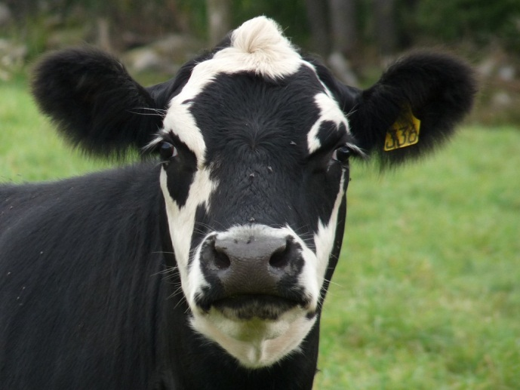
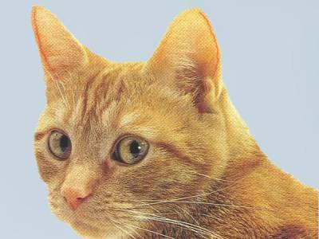
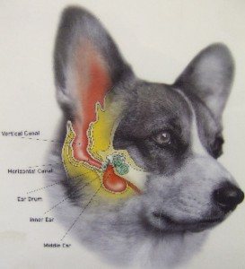
Ears of different animals
OTOLOGY

Slide 6
External ear anatomy
Pinna – auricle covered with skin and made of elastic cartilage.
External auditory meatus- ear canal lined with skin and ceruminous glands passes through temporal bone.
Tympanic membrane – “ear drum” separates outer ear from middle ear and is innervated with sensory fibers from trigeminal and vagus nerves. Responds to air vibrations or sound waves and transfers energy to middle ear ossicles.
OTOLOGY

Slide 7
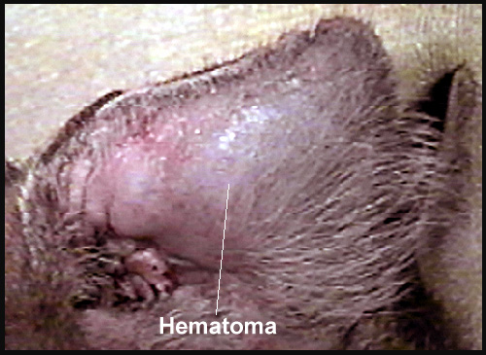
1- Aural hematoma
It results from direct trauma or self mutilation by the animal. The lesion is best treated as Surgical drainage under anesthesia combined with treatment of any Underlying otitis externa.
OTOLOGY

Slide 8
Clinical signs:
If there was a large swelling in the ear and the flap was swollen. The diagnosis is an aural, or ear hematoma.
An ear hematoma is a collection of blood, blood clots, and/or fibrous tissue that gets trapped between the skin and cartilage of the ear. They are common in animals that have ear infections. Ear infections are often very itchy and uncomfortable and cause animals to shake their heads and scratch at their ear.
OTOLOGY

Slide 9
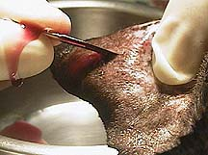
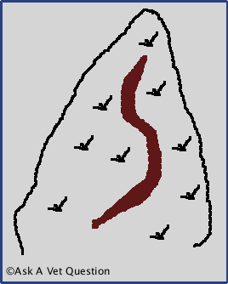
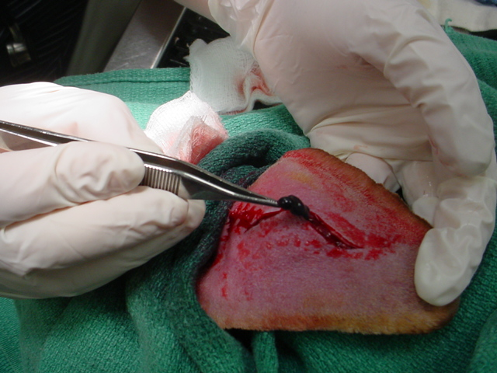
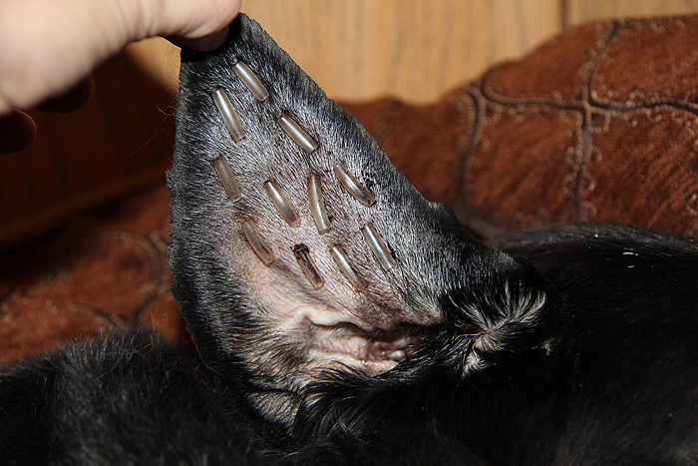
Treatment
OTOLOGY

Slide 10
2- Evaluation of Hearing
The hearing test known as the Brainstem Auditory Evoked Response (BAER) detects electrical activity in the cochlea and auditory pathways in the brain in much the same way that an antenna detects radio or TV signals or an EKG detects electrical activity of the heart.
The response from an ear that is deaf is an essentially flat line.
OTOLOGY

Slide 11
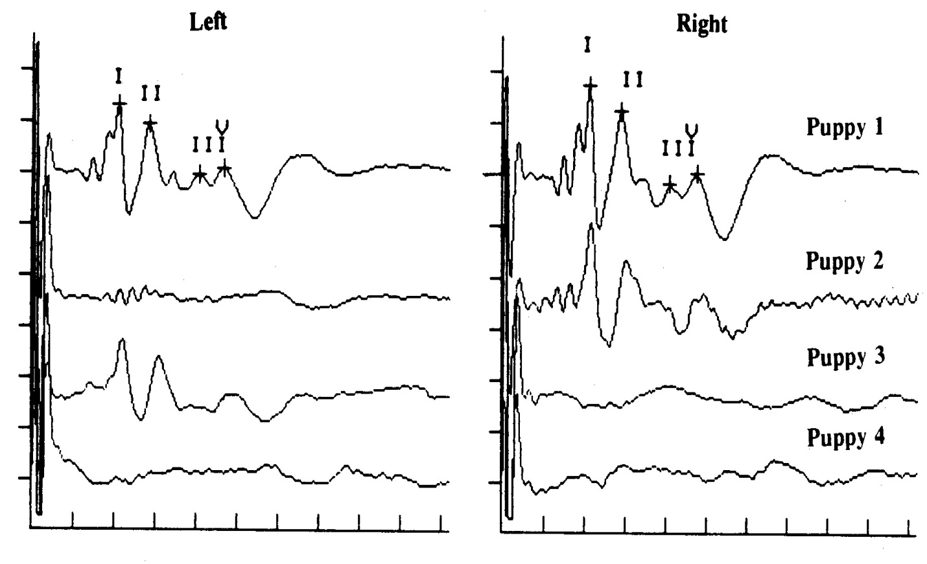
OTOLOGY

Slide 12
In cats, a high prevalence of deafness is observed in white cats with blue irises.
OTOLOGY

Slide 13
THANK YOU FOR ATTENTION

