Slide 1
Inflammation
Inflammation: it is a process (structural , biochemical and morphological ) change occur in the vital tissue as a response to sub lethal injury, begins following the injury and ends with complete healing.
Causes of inflammation :
1-Physical factors e.g. mechanical trauma (trauma, wound) , heat, cold , radiation (ultra violate or ionized radiation ) and electricity.
2-Chemical factors , such as acid, alkaline, caustics, chemical irritants, bacterial toxins , poisons (except cyanide and strychnine do not cause inflammation or necrosis ?).
3-Pathogenic organism e.g. bacteria , viruses , fungi, protozoa, parasite .
4-Immune reaction ---antigen antibody reaction or lymphocyte antigen reaction e.g. autoimmune disease , delayed hypersensitivity reaction---- etc)

Slide 2
Sequences of Inflammation
Inflammation occurs due to : 1- circulatory changes 2-chemical mediators.
*The circulatory changes include:
1- Active hyperemia --- firstly transient vasoconstriction occur following by vasodilatation and vascular congestion , and this was the cause of redness and hotness.
2-Exudation—exudation of the surrounding tissue , due to the increase in the permeability of B.V. due to vasodilatation.
3-Reduce the blood flow ---due to vasodilatation.
4-Emigration of leukocytes- firstly Margination of leukocytes ( pavmentation ) was occur as a result to the increase of blood viscosity due to reduce of blood flow ( axial streaming changed to abaxial streaming ). Then emigration of leukocytes ( specially neutrophile ). Under the effect of chemotaxis due to (tissue damage , the microorganism). Followed by diapedesis of erythrocytes.

Slide 3
The chemical mediators include:
-Mediators derived from the plasma e.g. kinin, complement system.
-Mediators released by cell e.g. Histamine, 5-HT, Prostaglandin(PGE₂ and PGI₂).
The chemical mediator responsible for:
1-Active hyperemia 2-increase the permeability of B.V
Inflammation in general have two reaction.
1- Local reaction ---make the cardinal signs of inflammation which are hotness, redness, swelling, painful and loss of function.
2-General reaction (systemic) —fever , increase pulse and respiratory rate and excitement, depression , coma and death.

Slide 4
Classification of the Inflammation
according to
Exudates - serous, catarrhal, mucosal, fibrinous, purulent, hemorrhagic, membranous, etc.
Duration - acute and chronic .
Tissue changes -adhesive, obliterative , hyperplastic, atrophic, granulomatous, necrotic.
Extent and tissue involvement- diffuse, focal, disseminated, interstitial, paranchymatous, etc. .
Etiology—caused by microorganisms, mechanical , chemical
Location – metastasis, reactive
Organ involved.

Slide 5
Sequelae of Inflammation
1-Resolution – complete resolution to the normal , which occur only when the damaged area is less.
2-Suppuration –occur when there is bacteria
3-Healing by scar tissue—occur when large area of damage and fibrous is the ultimate outcome.
4-Chronic inflammation –when persist for weeks or months after initial injury.

Slide 6
The Effects of Acute Inflammation
A-Beneficial effect:
1–Exudates dilute the toxin , protective antibody, fibrin formation, stimulation of immune system , cellular nutrition
2-Phagocytosis – removal of irritant ( causative agent) .
B-Harmful effect: 1-Hypersensitivity reaction 2-Swelling

Slide 7
TREATMENT
Acute inflammation
1- Removal of the causes.
2- Rest ( immobilization of the part ; prevent the spread of inflammation , reduce swelling , help healing with less scar formation , support damaged structures )
3- Cold application a- cold water bath b- ice
The purpose of cold application: is to relief pain , and prevent the vasodilatation , and the exudation by using of cold application (prevent edema and tissue swelling)
4- Anodyne preparation such as xylocaine jelly .

Slide 8
5- Compression –application of compression bandage help in avoid inflammation swelling. It should be done after massage - gentle massage with the direction of venous and lymphatic stream. The correct application of pressure bandage to 1-protect the wound 2- immobilization 3- reduce swelling /is an art that must be learned through experience ( not too tied , or not too loose ).
(when bandaging the upper portion of the leg , a bandage is first applied to the lower portion to maintain the position and to prevent edema of the distal extremity).
6- Anti inflammatory drugs : NSAID ( Aspirin , Indomethacin ,Phenylbutazone, Ibuprofen, Naproxen, Diclofenac, Mefenamic acid, Anti cox ), Corticosteroids.

Slide 9
TREATMENT
Chronic inflammation
1-Warm application. This is useful for:
a- promote circulation.
b- enhance resorption of exudates by enhance the whole process of inflammation .
Hot fomentation:
A-Dry heat (Temperature 40ºC to 44.5ºC) – e.g. ( heated sand , heated rice bran covered in cloth , hot water bottle).
B-Moist heat e.g. cloth dipped in hot water .(hot water poultices).

Slide 10
2-Cataplasms ; these agents act by the high osmotic tension to draw fluid from the part toward the surface. such as magnesium sulfate, boric acid paste, kaolin poultice, Denver Mud , Unnas paste .
3-Counter irritant : Drugs which convert chronic inflammation into acute; such as
a-Rubefacient like liniment (camphor liniment, chloroform liniment).
b-Blisters or vesicants ; such as ( red iodide of mercury).

Slide 11
4-Firing : Point Line
5-Scarfication –make multiple incisions.
6-Radiation therapy by X-ray, or Gamma radiation , and ultra violate .
7- Infrared light.
8- Ultrasound.
9- Laser therapy 1.058 J/sec. ( low level laser therapy (LLLT) ).
10- Shock wave therapy, by using special type of ultrasound.
11- Faradic current, ( electric stimulation, Galvanic and Faradic ).
12- Massage
13- Exercise
14- Hydrotherapy
15-Microwaves

Slide 12
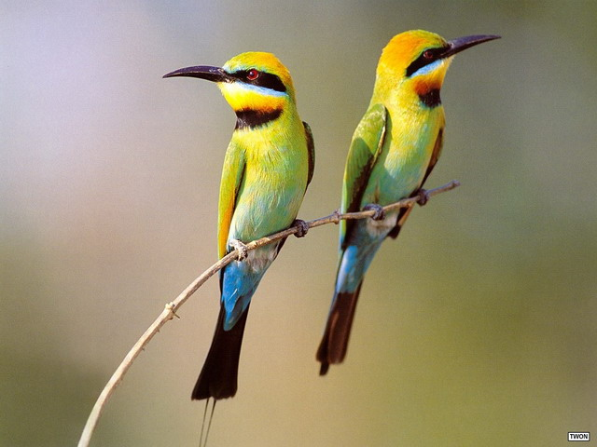
THANK U 4 LISTENING
THANK U 4 ATTENTION

